Slide 1
Hearken
Like You’ve Never
Hearkened Before
I Samuel 8 - Inspiration for Evangelism

Slide 2
Keypoint #1
We are to be displeased with sin to the point of intercession

Slide 3
It’s what shepherds do
“Wilt thou also destroy the righteous with the wicked?”
Abraham
“if thou wilt forgive their sin...if not, blot me... out”
Moses
“I rent my garment… and plucked the hair of my head”
Ezra
References: Genesis 18:23; Exodus 32:30-32; Deut. 9:19; Ezra 9:3-4

Slide 4
Keypoint #2
We are to hearken unto the Lord rather than man

Slide 5
Definition of Hearken
Bless the LORD, ye his angels, that excel in strength, that do his commandments, hearkening unto the voice of his word.
-Psalm 103:20

Slide 6
The Lord hearkened
For I was afraid of the anger and hot displeasure, wherewith the LORD was wroth against you to destroy you. But the LORD hearkened unto me at that time also.
-Deuteronomy 9:19

Slide 7
The Lord hearkened
Then they that feared the LORD spake often one to another: and the LORD hearkened, and heard it, and a book of remembrance was written before him for them that feared the LORD, and that thought upon his name.
-Malachi 3:16

Slide 8
Keypoint #3
Our failure is not man rejecting the gospel but rather man not hearing the gospel

Slide 9
We Must Preach
How then shall they call on him in whom they have not believed? and how shall they believe in him of whom they have not heard? and how shall they hear without a preacher?
-Romans 10:14

Slide 10
We Must Preach
And how shall they preach, except they be sent? as it is written, How beautiful are the feet of them that preach the gospel of peace, and bring glad tidings of good things!
-Romans 10:15

Slide 11
We Are Jonah
Arise, go to Nineveh, that great city, and cry against it; for their wickedness is come up before me.
-Jonah 1:2

Slide 12
We Are Jonah
And Jonah began to enter into the city a day’s journey, and he cried, and said, Yet forty days, and Nineveh shall be overthrown.
-Jonah 3:4

Slide 13
Keypoint #4
We are to warn & gravely protest the consequences of sin to those around us

Slide 14
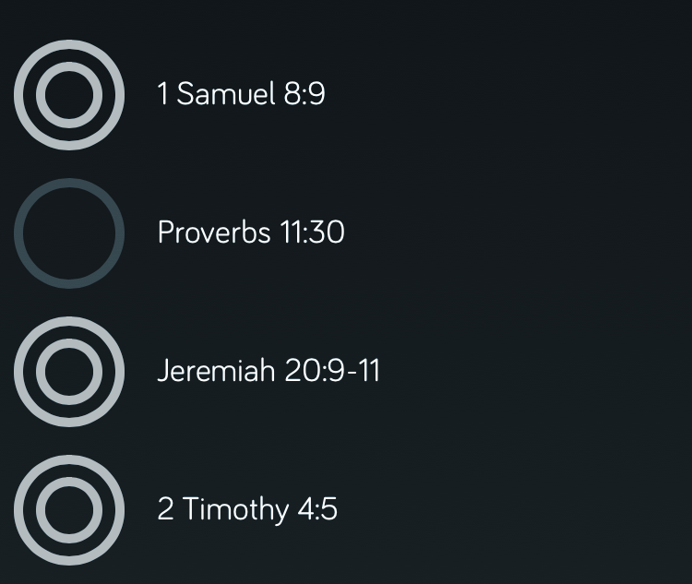
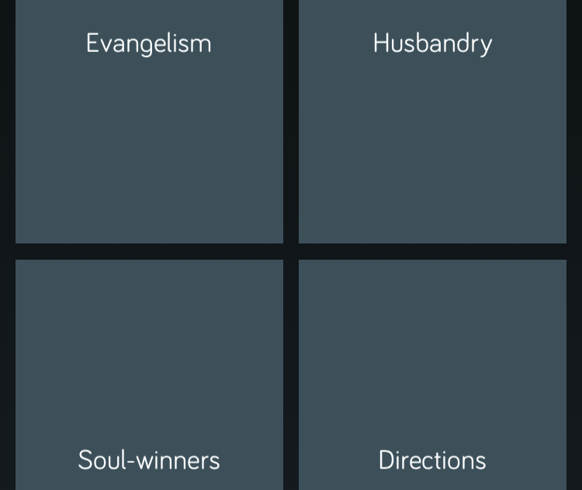
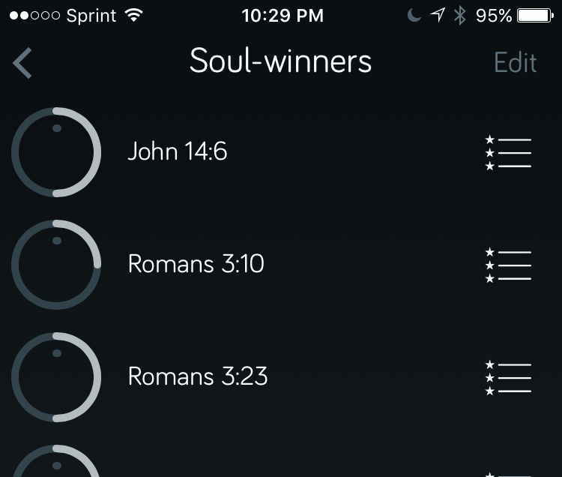
Bible Memory

Slide 15
God’s word is a fire
Then I said, I will not make mention of him, nor speak any more in his name. But his word was in mine heart as a burning fire shut up in my bones, and I was weary with forbearing, and I could not stay.
-Jeremiah 20:9

Slide 16
Give the gift of faith
So then faith cometh by hearing, and hearing by the word of God.
-Romans 10:17

Slide 17
Keypoint #5
Beware… God will hearken unto you
(for better or worse)

Slide 18
Desires of the heart
Delight thyself also in the LORD; and he shall give thee the desires of thine heart.
-Psalm 37:4

