Slide 1

Where Honor Is Due / Acts 14:8-20

Slide 2
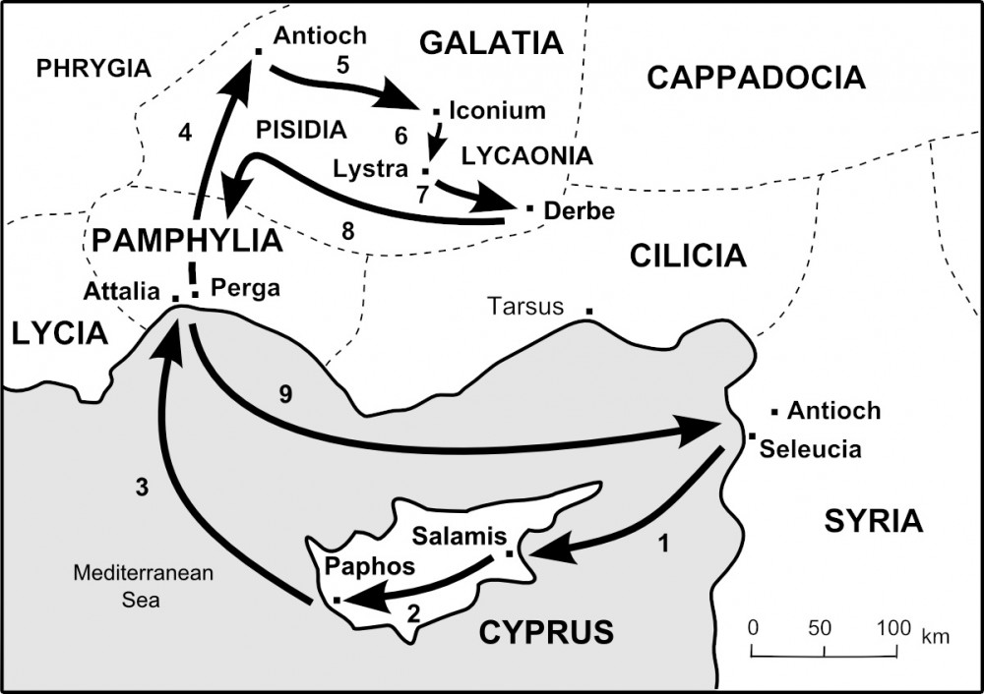

Slide 3
Establishing a Pattern of Ministry pt 2 / Acts 14:1-7

Slide 4

Where do I place my faith?
Where do I direct my praise?

Slide 5
  Act 14:8 And there sat a certain man at Lystra, impotent in his feet, being a cripple from his mother's womb, who never had walked: 9 The same heard Paul speak: who stedfastly beholding him, and perceiving that he had faith to be healed, 10 Said with a loud voice, Stand upright on thy feet. And he leaped and walked.

Slide 6

Key Point #1
Healing of the soul is greater than
the healing of the body.

Slide 7
  Act 14:8 And there sat a certain man at Lystra, impotent in his feet, being a cripple from his mother's womb, who never had walked: 9 The same heard Paul speak: who stedfastly beholding him, and perceiving that he had faith to be healed, 10 Said with a loud voice, Stand upright on thy feet. And he leaped and walked.

Slide 8
The Exaltation of Men
11 And when the people saw what Paul had done, they lifted up their voices, saying in the speech of Lycaonia, The gods are come down to us in the likeness of men. 12 And they called Barnabas, Jupiter; and Paul, Mercurius, because he was the chief speaker. 13 Then the priest of Jupiter, which was before their city, brought oxen and garlands unto the gates, and would have done sacrifice with the people.

Slide 9
  “Pride must die in you, or nothing of heaven can live in you.”
Andrew Murray
Missionary to South Africa

Slide 10
“Here is the path to the higher life: down, lower down! Just as water always seeks and fills the lowest place, so the moment God finds men abased and empty, His glory and power flow in to exalt and to bless.”
Andrew Murray
Missionary to South Africa

Slide 11
“Humility is nothing but the disappearance of self in the vision that God is all.”
- Andrew Murray
Missionary to South Africa

Slide 12
The Exaltation of Men
Act 12:21 And upon a set day Herod, arrayed in royal apparel, sat upon his throne, and made an oration unto them. 22 And the people gave a shout, [saying, It is] the voice of a god, and not of a man. 23 And immediately the angel of the Lord smote him, because he gave not God the glory: and he was eaten of worms, and gave up the ghost.

Slide 13
Key Point #2
God does not tolerate any threat to his glory.

Slide 14
Key Point #3
Our primary concern is the worship of God,
so we defer all personal elevation to the Godhead..

Slide 15
The Exaltation of God
14 [Which] when the apostles, Barnabas and Paul, heard [of], they rent their clothes, and ran in among the people, crying out, 15 And saying, Sirs, why do ye these things? We also are men of like passions with you,.

Slide 16
The Exaltation of God
14 [Which] when the apostles, Barnabas and Paul, heard [of], they rent their clothes, and ran in among the people, crying out, 15 And saying, Sirs, why do ye these things? We also are men of like passions with you, and preach unto you that ye should turn from these vanities unto the living God, which made heaven, and earth, and the sea, and all things that are therein:

Slide 17
The Exaltation of God
14 [Which] when the apostles, Barnabas and Paul, heard [of], they rent their clothes, and ran in among the people, crying out, 15 And saying, Sirs, why do ye these things? We also are men of like passions with you, and preach unto you that ye should turn from these vanities unto the living God, which made heaven, and earth, and the sea, and all things that are therein: 17 Nevertheless he left not himself without witness, in that he did good, and gave us rain from heaven, and fruitful seasons, filling our hearts with food and gladness. 18 And with these sayings scarce restrained they the people, that they had not done sacrifice unto them.

Slide 18
The Exaltation of God
19 And there came thither [certain] Jews from Antioch and Iconium, who persuaded the people, and, having stoned Paul, drew [him] out of the city, supposing he had been dead. 20 Howbeit, as the disciples stood round about him, he rose up, and came into the city: and the next day he departed with Barnabas to Derbe.

