Slide 1
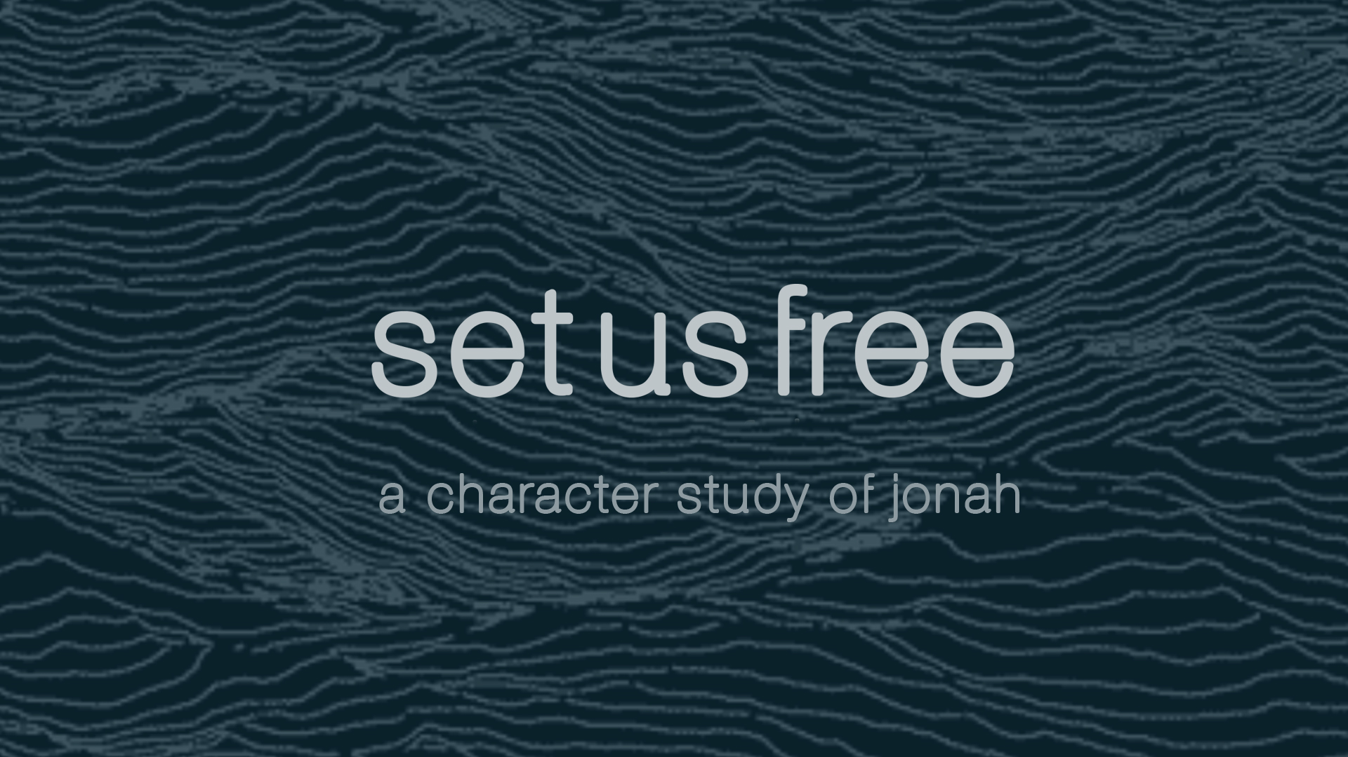

Slide 2

Last week…
Jon 1:14 Wherefore they cried unto the LORD, and said, We beseech thee, O LORD, we beseech thee, let us not perish for this man's life, and lay not upon us innocent blood: for thou, O LORD, hast done as it pleased thee. 15 So they took up Jonah, and cast him forth into the sea: and the sea ceased from her raging. 16 Then the men feared the LORD exceedingly, and offered a sacrifice unto the LORD, and made vows.
Type to enter a caption.

Slide 3
What about Jonah…?
Mat 12:39 But he answered and said unto them, An evil and adulterous generation seeketh after a sign; and there shall no sign be given to it, but the sign of the prophet Jonas: 40 For as Jonas was three days and three nights in the whale's belly; so shall the Son of man be three days and three nights in the heart of the earth. 41 The men of Nineveh shall rise in judgment with this generation, and shall condemn it: because they repented at the preaching of Jonas; and, behold, a greater than Jonas [is] here.
Type to enter a caption.

Slide 4
7b) Free Us By Repentance
Type to enter a caption.

Slide 5
7b) Free Us By Repentance
1:17 Now the LORD had prepared a great fish to swallow up Jonah. And Jonah was in the belly of the fish three days and three nights.
Type to enter a caption.

Slide 6
KEY POINT #1:
All wandering Christians are at risk
of God’s relentless pursuit.
Type to enter a caption.

Slide 7
God’s Faithfulness In Jonah’s Repentance
God Hears Our Prayers
Jon 2:1 Then Jonah prayed unto the LORD his God out of the fish's belly, 2 And said, I cried by reason of mine affliction unto the LORD, and he heard me; out of the belly of hell cried I, [and] thou heardest my voice. 3 For thou hadst cast me into the deep, in the midst of the seas; and the floods compassed me about: all thy billows and thy waves passed over me.
Type to enter a caption.

Slide 8
KEY POINT #2:
Knowing Christ is to savor his affection
and to spare our heartache.
Type to enter a caption.

Slide 9
God’s Faithfulness In Jonah’s Repentance
God Hears Our Prayers
Jon 2:1 Then Jonah prayed unto the LORD his God out of the fish's belly, 2 And said, I cried by reason of mine affliction unto the LORD, and he heard me; out of the belly of hell cried I, [and] thou heardest my voice.
Psa 34:4 I sought the LORD, and he heard me, and delivered me from all my fears.
Psa 66:19 [But] verily God hath heard [me]; he hath attended to the voice of my prayer.
Psa 118:21 I will praise thee: for thou hast heard me, and art become my salvation.
Type to enter a caption.

Slide 10
KEY POINT #3:
God hears and responds when
his children call out.
Type to enter a caption.

Slide 11
God’s Faithfulness In Jonah’s Repentance
2. God Honors Our Cry of Faith
4 Then I said, I am cast out of thy sight; yet I will look again toward thy holy temple. 5 The waters compassed me about, [even] to the soul: the depth closed me round about, the weeds were wrapped about my head. 6 I went down to the bottoms of the mountains; the earth with her bars [was] about me for ever: yet hast thou brought up my life from corruption, O LORD my God. 7 When my soul fainted within me I remembered the LORD: and my prayer came in unto thee, into thine holy temple. 8 They that observe lying vanities forsake their own mercy. 9 But I will sacrifice unto thee with the voice of thanksgiving; I will pay [that] that I have vowed. Salvation [is] of the LORD.
Type to enter a caption.

Slide 12
KEY POINT #4:
Getting back to God’s affection is
a matter of going back home.
Type to enter a caption.

Slide 13
God’s Faithfulness In Jonah’s Repentance
How to find your way back home.
Direct your eyes.
Jonah 2:4 Then I said, I am cast out of thy sight; yet I will look again toward thy holy temple
Psa 25:15 Mine eyes [are] ever toward the LORD; for he shall pluck my feet out of the net.
Psa 26:3 For thy lovingkindness [is] before mine eyes: and I have walked in thy truth.
Type to enter a caption.

Slide 14
KEY POINT #5:
Your feet can’t go where your
eyes aren’t turned.
Type to enter a caption.

Slide 15
God’s Faithfulness In Jonah’s Repentance
How to find your way back home.
Direct your eyes.
Direct your mind.
7 When my soul fainted within me I remembered the LORD
Isaiah 46:3-8
8 Remember this, and shew yourselves men: bring [it] again to mind, O ye transgressors. 9 Remember the former things of old: for I [am] God, and [there is] none else; [I am] God, and [there is] none like me, 10 Declaring the end from the beginning, and from ancient times [the things] that are not [yet] done, saying, My counsel shall stand, and I will do all my pleasure:
Type to enter a caption.

Slide 16
KEY POINT #6:
“Remembering God” is a
discipline of desperations.
Type to enter a caption.

Slide 17
God’s Faithfulness In Jonah’s Repentance
How to find your way back home.
Direct your eyes.
Direct your mind.
Direct your words.
7…and my prayer came in unto thee, into thine holy temple.
Psa 18:6 In my distress I called upon the LORD, and cried unto my God: he heard my voice out of his temple, and my cry came before him, [even] into his ears.
Type to enter a caption.

Slide 18
KEY POINT #7:
Know that God’s ears are
always open to you.
Type to enter a caption.

Slide 19
God’s Faithfulness In Jonah’s Repentance
How to find your way back home.
Direct your eyes.
Direct your mind.
Direct your words.
Direct your sacrifice.
9 But I will sacrifice unto thee with the voice of thanksgiving; I will pay [that] that I have vowed. Salvation [is] of the LORD.
Type to enter a caption.

Slide 20
KEY POINT #8:
Sacrifice is only as good as
the subsequent level of surrender.
Type to enter a caption.

Slide 21
God’s Faithfulness In Jonah’s Repentance
3. God Restores Us
10 And the LORD spake unto the fish, and it vomited out Jonah upon the dry [land].
Type to enter a caption.

Slide 22
KEY POINT #9:
God’s forgiveness imparts a
renewed spirit and a reestablished path.
Type to enter a caption.

Slide 23
God’s Faithfulness In Jonah’s Repentance
3. God Restores Us
10 And the LORD spake unto the fish, and it vomited out Jonah upon the dry [land].
Jon 3:1 And the word of the LORD came unto Jonah the second time, saying, 2 Arise, go unto Nineveh, that great city, and preach unto it the preaching that I bid thee. 3 So Jonah arose, and went unto Nineveh, according to the word of the LORD.
Type to enter a caption.

Slide 24
KEY PRAYER:
Set me free to live a lifestyle of daily repentance so that I never stray to far from home.
.
Type to enter a caption.

