Slide 1
Numbers 20 7-8 Speak to the rock
Obedience and relationship with the Lord makes it possible to live out the promises he has made us.

Slide 2

Numbers in a nutshell
The book of numbers is a book about the wandering of the israelites through the wilderness. And the trials they faced, and the back and forths of them fearing and loving God, and them wanting to be back in egypt for the cucumbers…

Slide 3
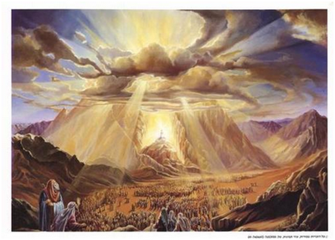
Numbers 12:6-8
The Lord spoke to Moses (mouth to mouth)
124 verses that reference the Lord speaking to moses
Not like other prophets where he came to them in dreams.
Exodus 33:11A “ And the Lord spake unto moses face to face,
As a man speaketh unto his friend”
Moses’ time with the Lord was crucial to
the work of the ministry God gave him.

Slide 4
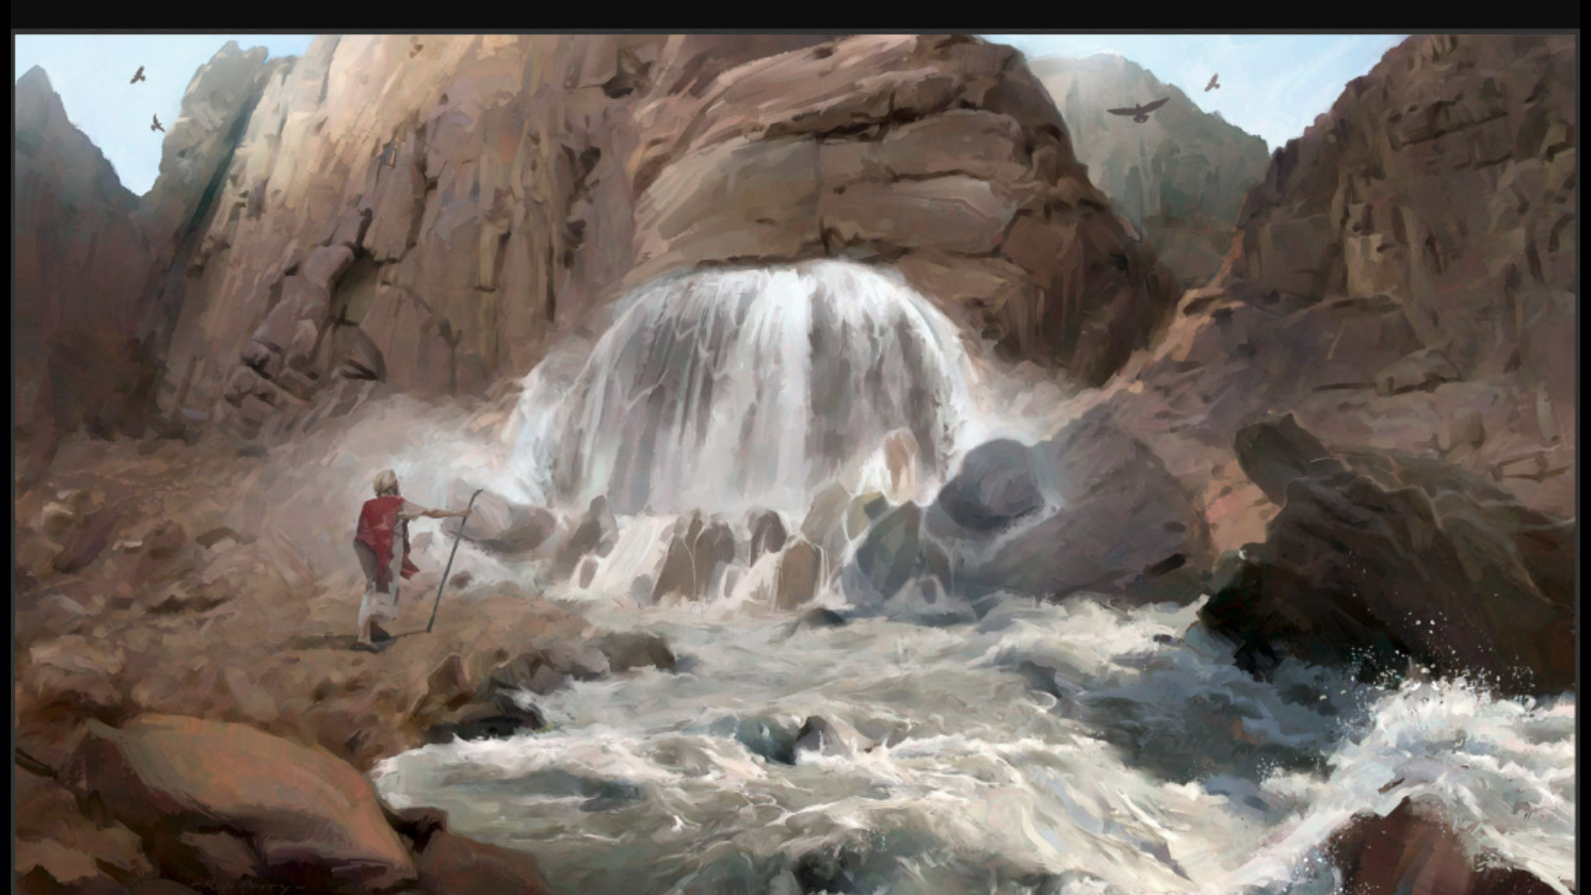
EXODUS 17:6
THE FIRST STRIKE
Moses is seeking out the Lord concerning the Israelites complaints about water. God gives him very specific instruction in order to quench the thirst of the people.

Slide 5
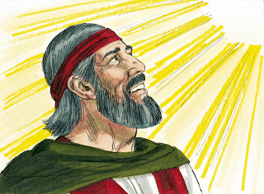

Exodus 17:6
“Behold, i will stand before thee there upon the rock in Horeb; and thou shalt smite the rock, and there shall come water out of it, that the people may drink. And Moses did so in the sight of the elders of Israel.”

Slide 6
WHAT THE ROCK PICTURES
It pictures the rock that we get our living water from, JESUS CHRIST.
1 corinthians 10:4 “And did all drink from the same spiritual drink: for they drank of that spiritual Rock that followed them: and that Rock was Christ.

Slide 7
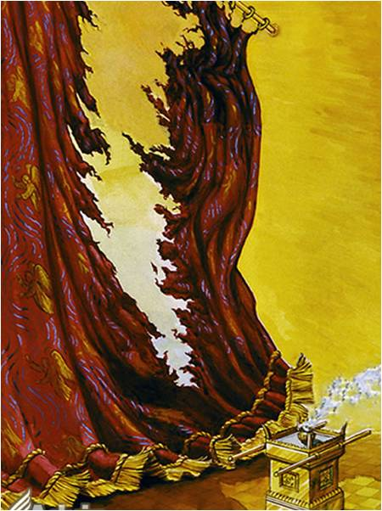
Key Point #1
When Christ (the rock) allowed himself to be stricken down for our salvation, we gained the ability to freely receive the living water of his Word.
-through speaking with him in prayer and studying his very Words!
-

Slide 8
This is crucial to the response we see from the Lord later on when Moses goes against what the Lord told him to do.
Also we see that everything that the Lord does is on purpose with a purpose.

Slide 9
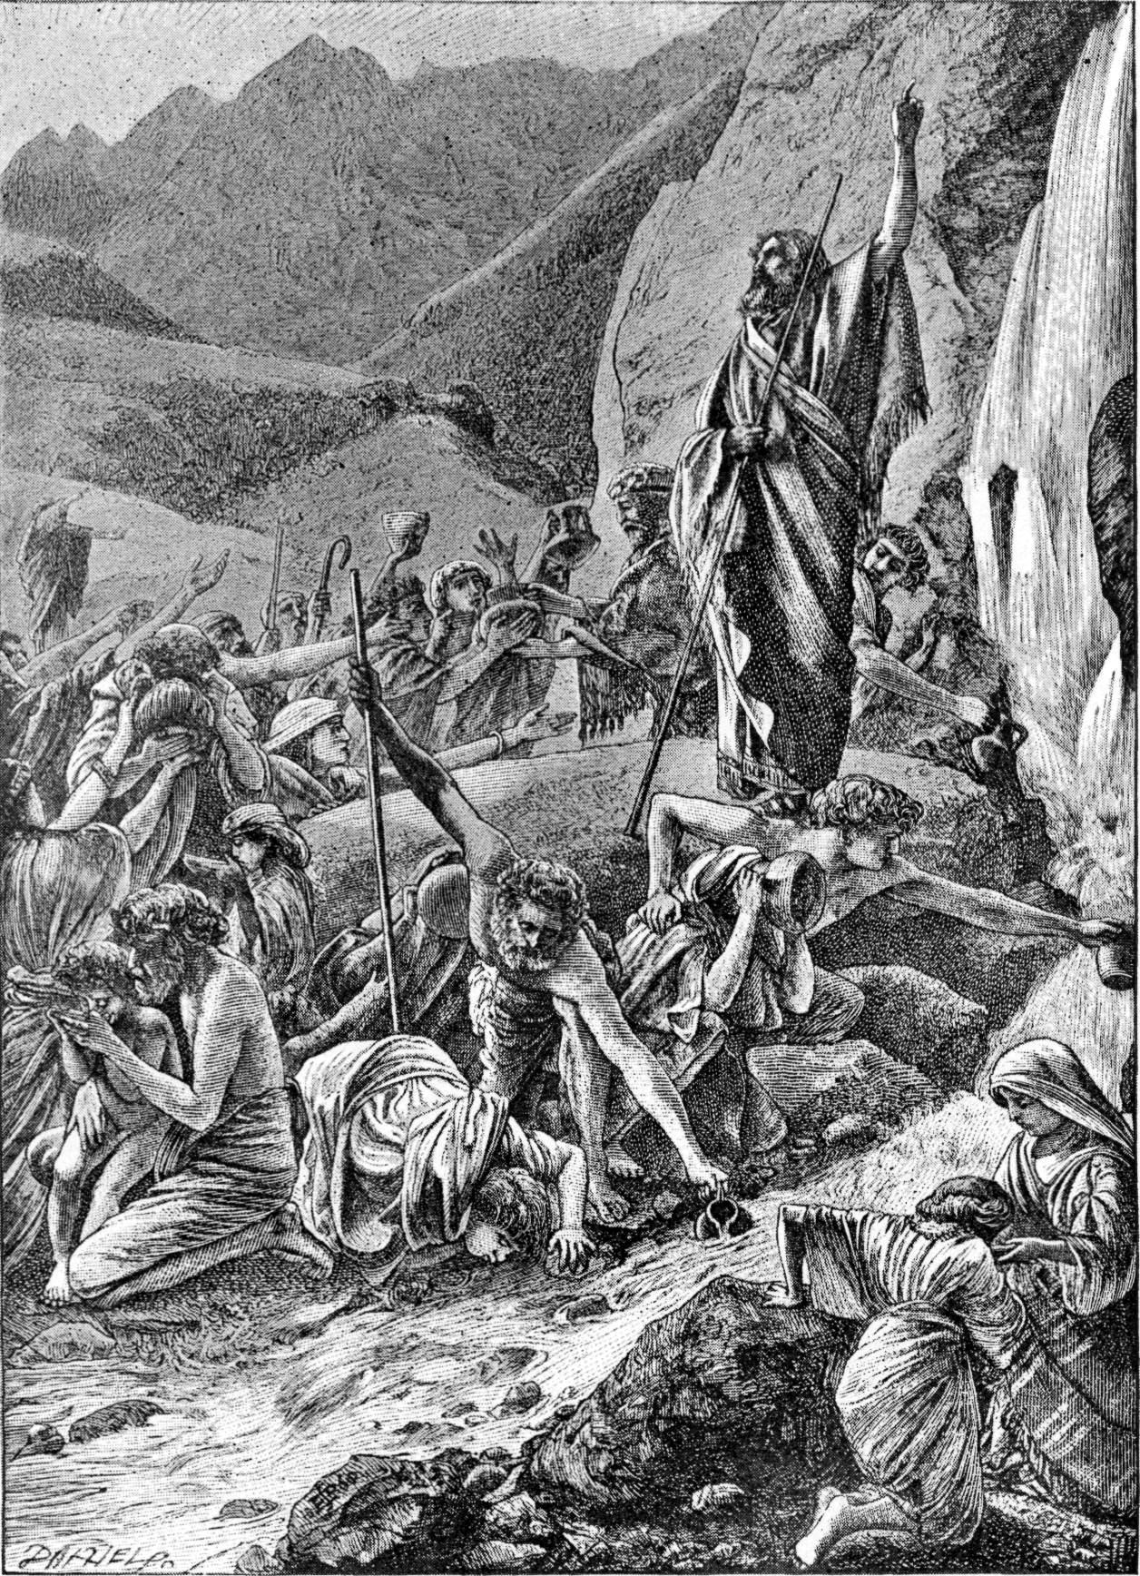
The second strike
The second time that Moses goes to God with the water problem it starts off very similarly, and actually looks very promising….. BUT there is a huge difference in the response from Moses.

Slide 10
Numbers 20:8
“Take the rod, and gather thou the assembly together thou, and Aaron thy brother, and speak ye unto the rock before their eyes; and it shall give forth his water, and thou shalt bring forth to them water out of the rock: so thou shalt give the congregation and their beasts drink.”

Slide 11
Moses’ response
Vs9 “And Moses took the rod from before the Lord, as he had commanded him. Vs10 and Moses and Aaron gathered the congregation together before the rock, and he said unto them, Hear now, ye rebels; must we fetch water out of this rock? Vs11 And Moses lifted up his hand , and with his rod he smote the rock twice: and the water came out abundantly, and the congregation drank, and their beasts also.”

Slide 12
God’s Response
Vs12 “And the Lord spake unto Moses and Aaron, Because ye believed me not, to sanctify me in the eyes of the children of israel , therefore ye shall not bring this congregation into the land which i have given them.”

Slide 13
Key Point #2
Being disobedient comes with consequences that we are not ready for.

Slide 14
God’s righteous judgement
Because Moses and Aaron didn’t believe God they weren’t able to enjoy the fullness of God’s promises in their lives.

Slide 15
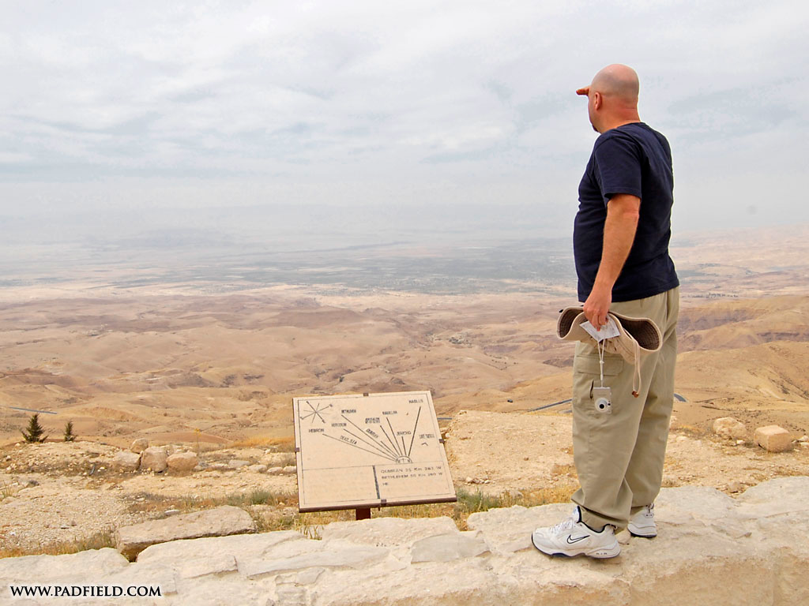
Christian wondering why God isn’t moving in his life
Gods promises
Area of unbelief

Slide 16
Key Point #3:
Be bold in prayer.
God had specifically told moses to speak to the rock before their eyes, so they could see the true power of the Lord, and so should we.

Slide 17
So practically for us.
Be aware of the fact that your life, as a christian, reflects Jesus Christ to the lost world.
Being obedient to God’s will results in blessing and revelation where our faith lacks.
Be Bold in what we pray for so that the world knows it was God that moved.

