Slide 1
Mission Critical
getting Perspective on the mission of the church

Slide 2
Mission Critical
Getting Perspective on the Mission of the church

Slide 3
Mission Critical
Getting Perspective on the Mission of the church
  The Call - Philosophical

Slide 4
Mission Critical
Getting Perspective on the Mission of the church
  The Call - Philosophical
  My Call - Example

Slide 5
Mission Critical
Getting Perspective on the Mission of the church
  The Call - Philosophical
  My Call - Example
  Your Call - Principal

Slide 6
Mission Critical
Getting Perspective on the Mission of the church
The Call

Slide 7
Mission Critical
Getting Perspective on the Mission of the church
The Call
Missions:

Slide 8
Mission Critical
Getting Perspective on the Mission of the church
The Call
Missions: The efforts of the church and its members to obey the great commission (Matt. 28:18-20; Acts 1:8)

Slide 9
Matt. 28:18-20
¹⁸ And Jesus came and spake unto them, saying, All power is given unto me in heaven and in earth.
¹⁹ Go ye therefore, and teach all nations, baptizing them in the name of the Father, and of the Son, and of the Holy Ghost:
²⁰ Teaching them to observe all things whatsoever I have commanded you: and, lo, I am with you always, even unto the end of the world. Amen.

Slide 10
Acts 1:8
⁸ But ye shall receive power, after that the Holy Ghost is come upon you: and ye shall be witnesses unto me both in Jerusalem, and in all Judaea, and in Samaria, and unto the uttermost part of the earth.

Slide 11
Mission Critical
Getting Perspective on the Mission of the church
The Call

Slide 12
Mission Critical
Getting Perspective on the Mission of the church
The Call
The call to missions is not an elective for the believer.

Slide 13
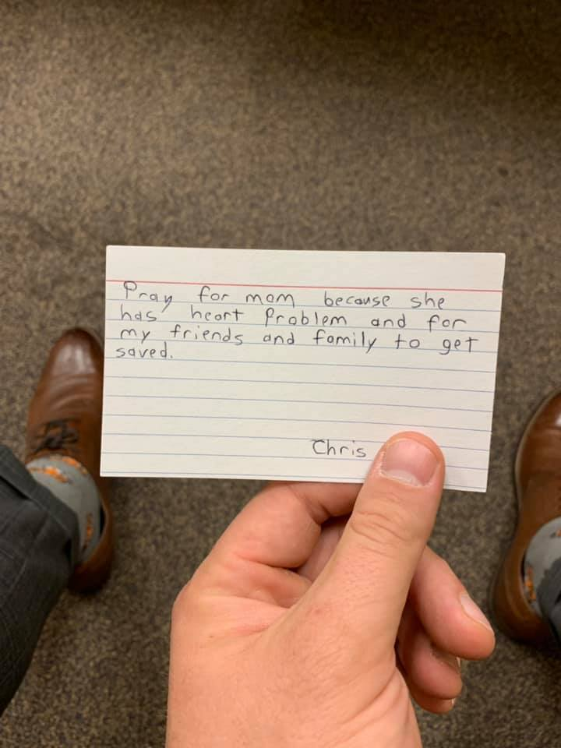

Slide 14
Mission Critical
Getting Perspective on the Mission of the church
The Call
The call to missions is not an elective for the believer.
The work of missions is not easy.

Slide 15
Mission Critical
Getting Perspective on the Mission of the church
The Call
The call to missions is not an elective for the believer.
The work of missions is not easy.
To succeed at missions, the church must execute.

Slide 16
Mission Critical
Getting Perspective on the Mission of the church
Our Call
“How do I know God has called me to Boston?”

Slide 17
Mission Critical
Getting Perspective on the Mission of the church
Our Call
Boston

Slide 18


Slide 19
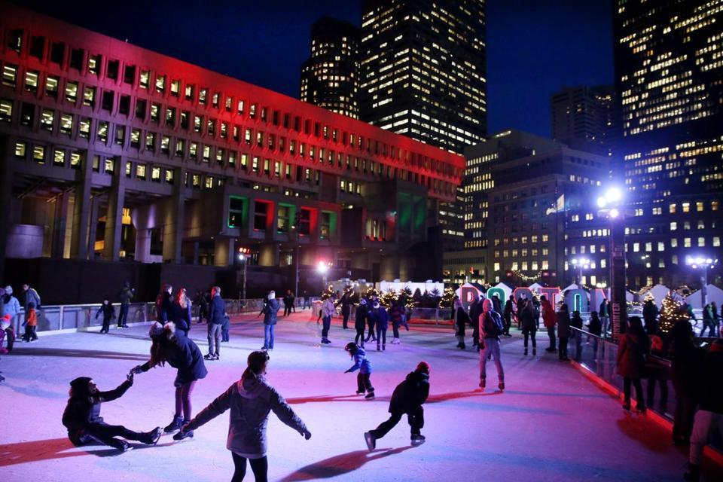

Slide 20
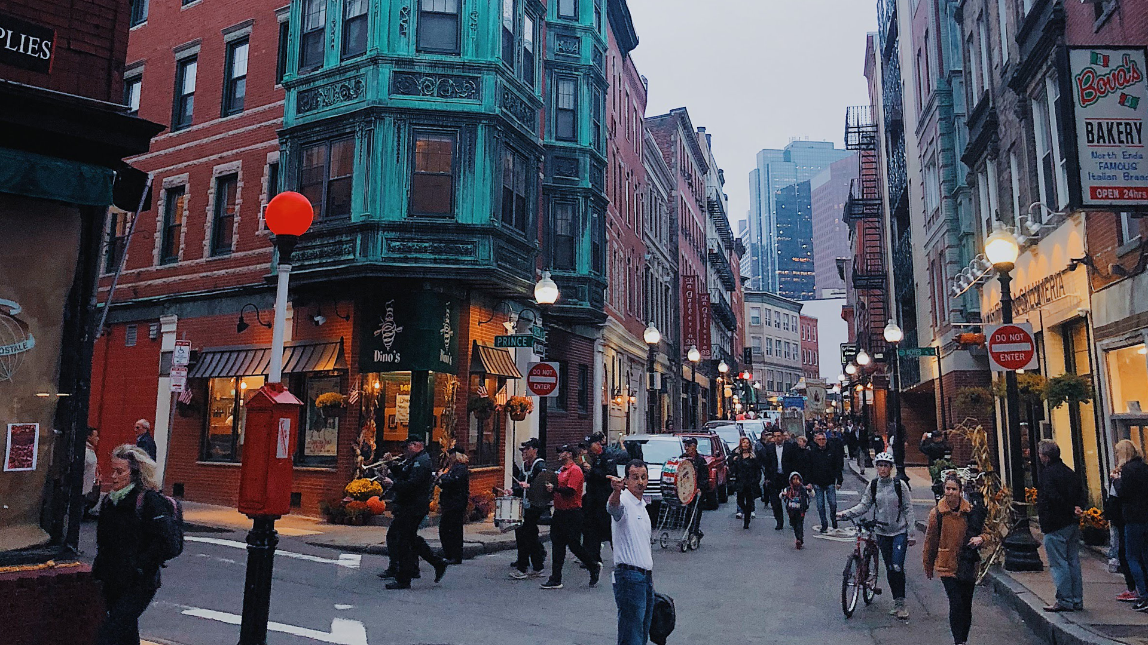

Slide 21
Mission Critical
Getting Perspective on the Mission of the church
Our Call
Boston Students – 50 mile radius
50+ colleges
260,000+ college students
60,000+ international students

Slide 22
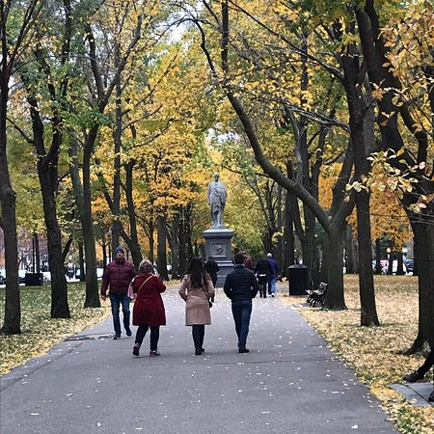

Slide 23
Eze. 22:30
³⁰ And I sought for a man among them, that should make up the hedge, and stand in the gap before me for the land, that I should not destroy it: but I found none.

Slide 24
Rom. 10:13, 14, 17
¹³ For whosoever shall call upon the name of the Lord shall be saved.
¹⁴ How then shall they call on him in whom they have not believed? and how shall they believe in him of whom they have not heard? and how shall they hear without a preacher?
…
¹⁷ So then faith cometh by hearing, and hearing by the word of God.

Slide 25
Mission Critical
Getting Perspective on the Mission of the church
Your Call
Decide - Philosophical buy-in
Do – Develop a Testimony of God’s leading

Slide 26
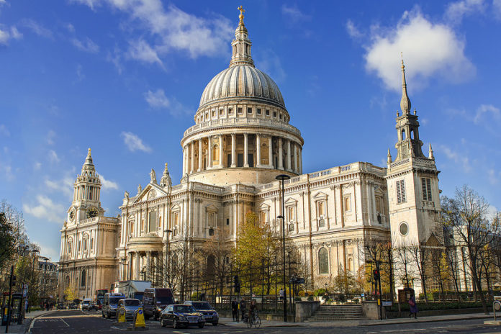

Slide 27
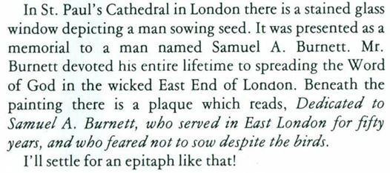

Slide 28
Mission Critical
Getting Perspective on the Mission of the church
Your Call
Decide - Philosophical buy-in
Do – Develop a Testimony of God’s leading
  Pray, Prepare, Give, Go

Slide 29
Mission Critical
Getting Perspective on the Mission of the church
Your Call
Pray for Boston
  For a team to be called out by the Lord
  For provision of resources, jobs, housing
  For open doors to share the gospel, start Bible studies
  For protection from the enemy

Slide 30
Mission Critical
Getting Perspective on the Mission of the church
Your Call
Prepare
  Get saved
  Get involved in your church – Bible Studies, Discipleship, LFBI
  Trust the Lord

Slide 31
Mission Critical
Getting Perspective on the Mission of the church
Your Call
Give
  Tithe
  Offerings

Slide 32
Mission Critical
Getting Perspective on the Mission of the church
Your Call
Go
  Come see the field – Fall ‘19 Discovery Trip to Boston
    Informational meeting March 12th in the West Balcony
  Join the team
    In prayer, in support, in buying the field

